Slide 1
Machine Learning Project
Bankruptcy Prediction

Slide 2
Team Members
Pooja Lanjewar
Rohit Vijay Maind
Imroza Shaik
Pavan Kumar Reddy
Kanya Naga Pavan
Rahul Kumar
Gumpu Chandra Sekhar
Naresh Kumar

Slide 3
TABLE OF CONTENTS
Introduction and Objective
Methodology
Data Preprocessing and Cleaning
Model Building and Evaluation
Data Analysis and Deployment
Challenges and Conclusion

Slide 4

Objective :
To develop a predictive model using machine learning algorithms to accurately identify companies at risk of bankruptcy, enabling early intervention and mitigating financial losses.

Slide 5

Bankruptcy is a serious financial crisis that can have devastating consequences for businesses, their employees, and the broader economy. Early detection of companies at risk of bankruptcy is crucial for preventing financial losses and taking timely corrective actions.

Slide 6

This research leverages a comprehensive dataset of financial indicators from various industries.
The data is preprocessed, cleaned, and normalized to ensure data quality and consistency.
Subsequently, machine learning algorithms such as logistic regression, decision trees, random forests, and support vector machines are employed to train and evaluate predictive models.
Model performance is assessed using metrics like accuracy, precision, recall, and F1-score.

Slide 7

Data preprocessing and data cleaning are essential steps in any data analysis project, ensuring that the data is accurate, consistent, and suitable for modeling. This process often involves handling missing values, outliers, and inconsistencies.

Slide 8
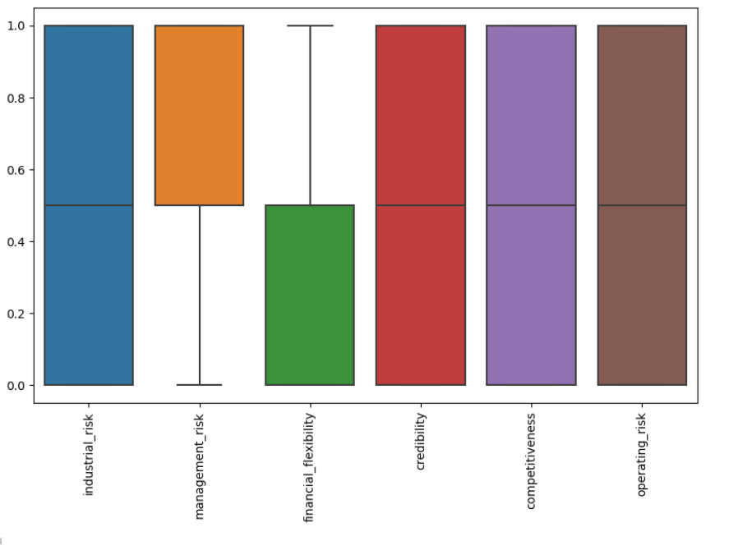
Box Plot
Identifying Outliers: Box plots can visually highlight outliers, which are data points that significantly deviate from the rest of the data. Outliers can skew statistical analysis and model performance
Understanding Data Distribution: Box plots also provide information about the data's distribution, including the median, quartiles, and interquartile range.

Slide 9
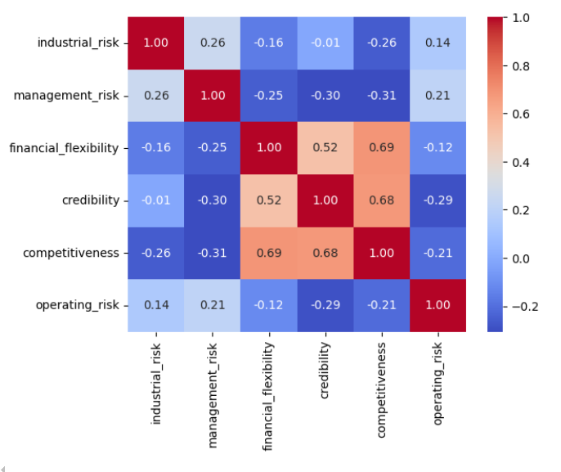
Heat Map
Correlations: Heatmaps can be used to visualize correlations between variables. A high correlation between two variables might indicate redundancy or multicollinearity, which can affect model performance.
Identifying Relationships: Heatmaps can help identify relationships that might not be immediately apparent from simple statistical analysis.

Slide 10

Model Building: Bankruptcy Prediction Using Machine Learning
Model building is a crucial phase in the bankruptcy prediction project, where machine learning algorithms are applied to the preprocessed data to create predictive models. These models can then be used to identify companies at risk of bankruptcy based on their financial characteristics.

Slide 11
Machine Learning Algorithms for Bankruptcy Prediction
Logistic Regression: A statistical model that predicts the probability of an event occurring
Support Vector Machines (SVMs): A supervised learning algorithm that finds the optimal hyperplane to separate data points into different classes.
Decision Trees: A tree-based model that makes decisions by splitting data into subsets based on specific conditions.
Random Forests: An ensemble method that combines multiple decision trees to improve prediction accuracy.
Knn Classifier: K-Nearest Neighbors (KNN) is a simple yet effective supervised machine learning algorithm that classifies new data points based on the majority class of their nearest neighbors.

Slide 12
Model Training and Evaluation
Model Training: The chosen machine learning algorithm is applied to the training set to learn the underlying patterns and relationships between financial indicators and bankruptcy.
Model Evaluation: The trained model is evaluated on the testing set using various metrics, such as:
Accuracy: The proportion of correct predictions.
Precision: The proportion of positive predictions that are actually positive
Recall: The proportion of actual positive cases that are correctly predicted as positive.
F1-score: The harmonic mean of precision and recall.
Confusion matrix: A table that summarizes the performance of a classification model.

Slide 13
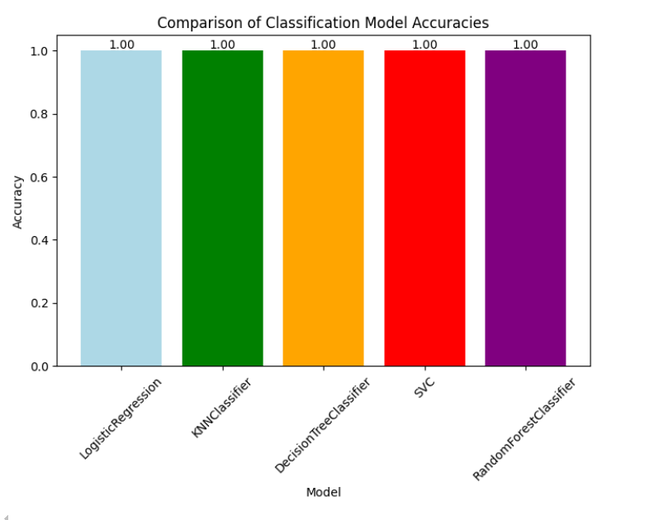
Comparison of Classification Model Accuracies

Slide 14
Conclusion
This research has demonstrated the potential of machine learning techniques to accurately predict bankruptcy. By leveraging a comprehensive dataset of financial indicators and employing advanced algorithms, predictive models can be developed that effectively identify companies at risk of financial distress.
Key Findings:
Machine learning's effectiveness: Machine learning algorithms, such as logistic regression, decision trees, and random forests, have shown promising results in bankruptcy prediction.

Slide 15


